Slide 1
A Feature-Based of IT Automation using<Your Tool>
Developed By: <your name> & <your teammate name if any>
Advisor : Dr. S. Masoud Sadjadi
School of Computing and Information Sciences
Florida International University
Your Email@fiu.edu
http://www.cs.fiu.edu/~sadjadi/

Slide 2
Agenda
Problem and Motivation
Solution
Behind the Scene
Customizing the Solution
Disclaimer
Progress Report

Slide 3
Problem and Motivation:
<Introduce a problem and motivate it. For example, machines are running out of disk space due to the increase of temporary files and motivate its importance and impact by showing how this problem could affect IT management everyday life. Screen shots can be added.>

Slide 4
Fig 1.1

Slide 5
Solution
<Find a solution to the problem and show how using IT Automation and Remote Control tools can help solve the introduced problem. For example, using Kaseya, you can make an agent procedure that will run disk clean up on a regular basis. Note that you would need to introduce the tools that you may be using to solve the problem. If the tool is Kaseya, there is no need for this introduction.>

Slide 6
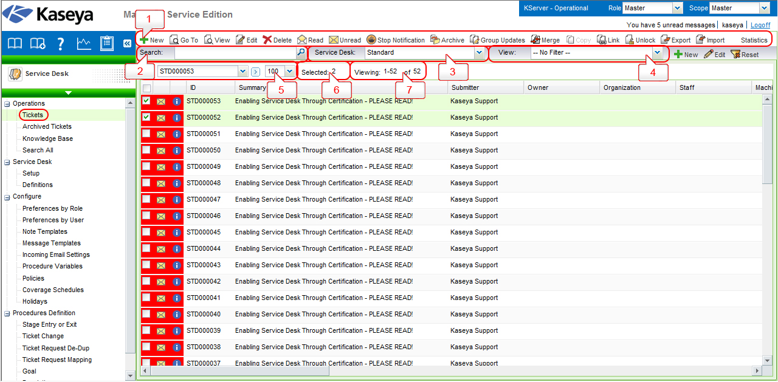
Fig 2.1

Slide 7
Behind the Scene
<In this part, explain in detail what is happening within each step in the process of solving the problem using the tools. For example, if you wrote an agent procedure that starts up the disk clean up, you would need to go through the steps and fully explain what is actually happening behind the scene. In case you use an out of box tool, it could be the case that some of the details are not completely clear to you. In such cases, you should just explain those parts that you can and indicate that you are not sure how the other parts work, but you can offer your intuition.>

Slide 8
Fig 3.1

Slide 9
Customizing the Solution
<It may be the case that you would need to customize your solution to work in different environments. For example, if the disk clean up works on Windows, what can be changed to make that procedure to work on Mac as well.>

Slide 10
Fig 4.1

Slide 11
Disclaimer
<What are the shortcomings of your solution? What can be improved about your solution? For example, if your disk clean up was tested only on Windows XP, you would need to indicate that you have not tested it on other Windows platforms, even though you guess that it should work without any problem. Also, if your solution were only good for Windows, for example, then you would need to indicate that it does not work on Mac, Linux, etc.>

Slide 12
Progress Report
How far have you gone with your solution?
What is still not done?
etc.

